Slide 1


DELUR SERVICES RETURN ANALYSIS
By: Mobolaji Falugba
19/08/2023

Slide 2
Business Objective.
Delur Services is a customer-centric company that provides a wide range of products to customers across different states. They take pride in delivering products on time and ensuring a seamless delivery performance to meet customers' expectations.
They want to obtain an overview of their data. They noticed discrepancies in their return rate and are looking towards achieving a target return rate of 5% for the coming year.

Slide 3
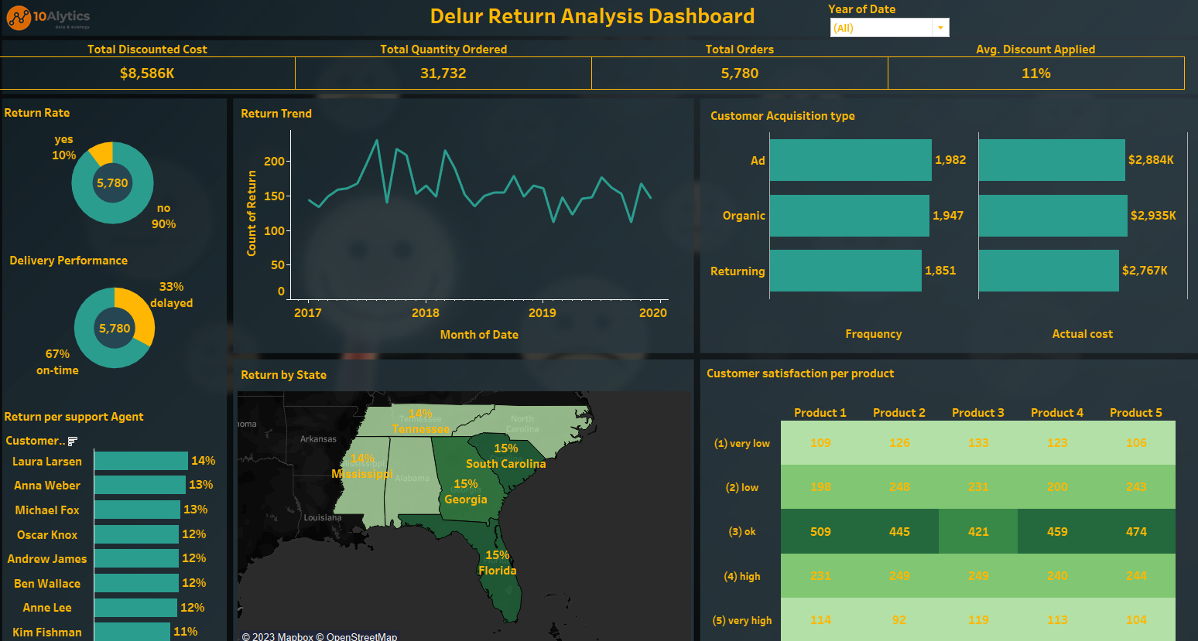

Slide 4


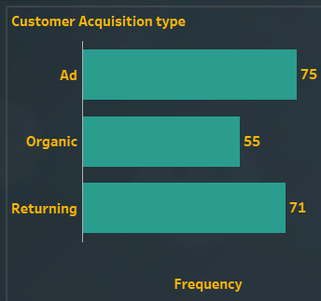
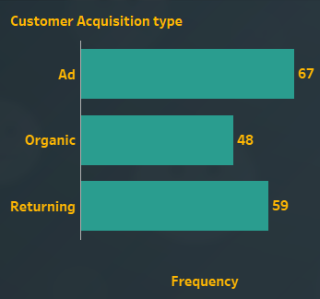
Analysis of Returns by the customer acquisition type.
This showed that the highest return was from customers acquired through Advertisement and this was a yearly pattern.

Slide 5
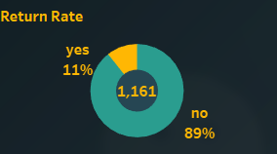
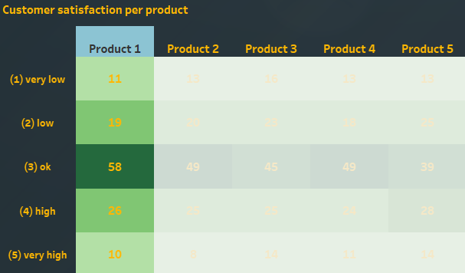
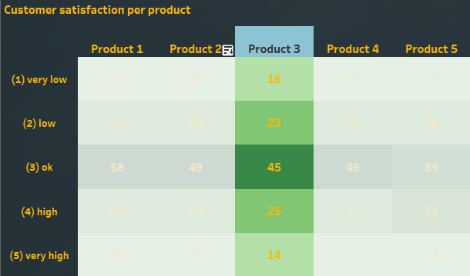
Analysis of Returns Per Product.
Products 1 and 3 have the highest return rate of 11% while others are 10%.

Slide 6
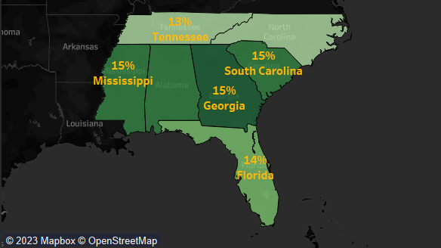
Analysis of Returns by State.
This showed that Mississippi, Alabama, Georgia, and South Carolina had the highest return rate of 15%.

Slide 7

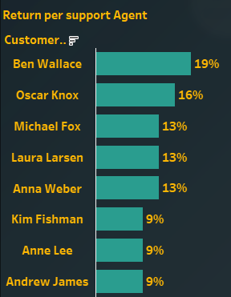
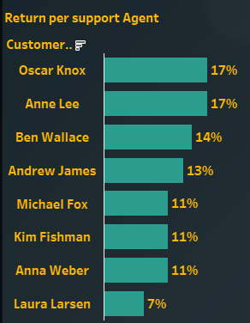
Analysis of Returns Per Support Agent.
This showed that there was no definite pattern in the returns per support agent. Agents who had low returns in the previous year had significantly high returns in the later years.

Slide 8
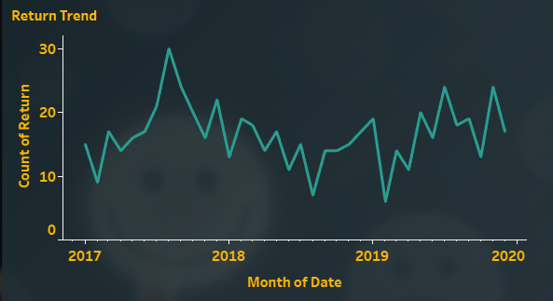
Analysis of Return Trend.
This showed that we had the highest return rate in 2017 with 30 returns which was followed by a sharp decline in 2018 with 19 returns and a slight rise in 2019 with 24 returns.

Slide 9
Recommendations by Customer Acquisition type
Targeted Product Information: Since the highest return rate was from customers acquired through Advertisements, the company should ensure that the product information provided through advertisements is accurate, comprehensive, and representative of the actual product. Misleading or incomplete information can lead to dissatisfaction upon receiving the product.
Clear Product Images: Include high-quality images of the product in advertisements. Clear and detailed images give customers a better understanding of what they are purchasing, reducing the likelihood of receiving a product that doesn't meet their expectations.

Slide 10
Recommendations from Product Analysis
Product Quality and Customer Satisfaction: The high return rate for products 1 and 3 suggests that there might be issues with the quality, functionality, or performance of these products. The company should Investigate whether there are consistent complaints or feedback from customers regarding these products and also focus on improving the overall quality and ensuring that these products meet customer expectations.
Price-Performance Ratio: The company should evaluate whether the unit price of products 1 and 3 is justified by their quality and features. If customers perceive that these products do not offer good value for their price, they might be more likely to return them. Consider adjusting pricing strategies if necessary.

Slide 11
Recommendations by Returns per State
Optimization of Delivery performance: South Carolina SC, Alabama AL, Mississippi MI, and Georgia GA were states with the highest return rates of 15%. Analysis of returned products to these states showed a high delay in the delivery of the products with SC having a 45% delay, AL 42%, MI 36%, and GA 33% while the average delay rate for other states was only 29%. The company should consider optimizing delivery performance in these states.

Slide 12
Recommendations by Support Agent
This showed that there was no definite pattern in the returns per support agent. Agents who had low returns in the previous year had significantly high returns in the later years. I suggest a Re-Orientation of the entire support agents on how to be more customer-centric

Slide 13
Recommendations by Return Trend (yearly)
Analysis of the return trend showed that product 1 had the highest return rate in 2018 and 2019 with 11% and 13% return rate, respectively. While the average return rate for other products in 2018 and 2019 was 8.5 and 11 returns, respectively.
The company should ensure that the product is of high quality and product descriptions are accurate and comprehensive, providing customers with clear expectations about what they are purchasing thus minimizing customer dissatisfaction.

Slide 14
THANKS FOR LISTENING.

